Slide 1
XML FILES & CSS
Simple Files
Collaboration to CSS
DTD Files

Slide 2
Viewing XML Files
Don't expect XML files to be displayed as HTML pages.
The XML document will be displayed with color-coded root and child elements.
A plus (+) or minus sign (-) to the left of the elements can be clicked to expand or collapse the element structure.
To view the raw XML source, select "View Page Source“ from the browser menu.
Why Does XML Display Like This?
Since XML tags are "invented" by the author of the XML document, browsers do not know if a tag like <table> describes an HTML table or a dining table.
Without any information about how to display the data, most browsers will just display the XML document as it is.

Slide 3
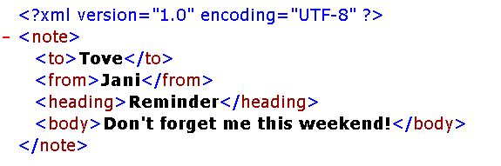

Viewing XML File’s OUTPUT: (Collapse code)
(Expandable code)

Slide 4
Displaying your XML Files with CSS?
<?xml version="1.0" encoding="UTF-8"?>
<?xml-stylesheet type="text/css" href="cd_catalog.css"?>
<CATALOG>
<CD> <TITLE>Empire Burlesque</TITLE> <ARTIST>Bob Dylan</ARTIST> <COUNTRY>USA</COUNTRY> <COMPANY>Columbia</COMPANY> <PRICE>10.90</PRICE> <YEAR>1985</YEAR> </CD>
<CD> <TITLE>Hide your heart</TITLE> <ARTIST>Bonnie Tyler</ARTIST> <COUNTRY>UK</COUNTRY> <COMPANY>CBS Records</COMPANY> <PRICE>9.90</PRICE> <YEAR>1988</YEAR> </CD></CATALOG>
An xml file “CDBOOK.xml”

Slide 5
Displaying your XML Files with CSS?
A CSS file “cd_catalog.css”
CATALOG
{
background-color: #00ff44;
width: 100%;
}
CD
{
display: block;
margin-bottom: 30pt;
margin-left: 0;
}
TITLE
{
color: #FF0000;
font-size: 20pt;
}
ARTIST
{
color: #0000FF;
font-size: 20pt;
}
COUNTRY,PRICE,YEAR,COMPANY
{
display: block;
color: #000000;
margin-left: 20pt;
}

Slide 6
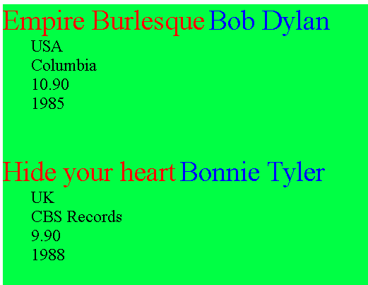
Browser output

Slide 7
XML Document Types
(01) XML DTD (02) XML Schema
A Document Type Definition (DTD) defines the legal building blocks of an XML document.
It defines the document structure with a list of legal elements and attributes.
A DTD can be declared inline inside an XML document, or as an external reference.
A document definition also provides a common reference that many users (developers) can share.
A document definition provides a standardization that makes life easier.

Slide 8
When NOT to Use a Document Definition?
XML does not require a document definition. When you are experimenting with XML, or when you are working with small XML files.
Creating document definitions may be a waste of time.
If you develop applications, wait until the specification is stable before you add a document definition. Otherwise, your software might stop working because of validation errors.

Slide 9
External DTD Declaration
<?xml version="1.0" encoding="UTF-8"?>
<!DOCTYPE note SYSTEM "Note.dtd">
<note> <to>Tove</to> <from>Jani</from> <heading>Reminder</heading> <body>Don't forget me this weekend!</body>
</note>
The DOCTYPE declaration, in the example above, is a reference to an external DTD file “Note.dtd”. The content of the file is shown in the next slide.

Slide 10
XML DTD file “Note.dtd”
<!DOCTYPE note [ <!ELEMENT note (to,from,heading,body)> <!ELEMENT to (#PCDATA)> <!ELEMENT from (#PCDATA)> <!ELEMENT heading (#PCDATA)> <!ELEMENT body (#PCDATA)>
]>
The DTD above is interpreted like this:
!DOCTYPE note defines that the root element of the document is note
!ELEMENT note defines that the note element contains four sub-elements: "to, from, heading, body"
!ELEMENTs (to, from, heading, body) define that the sub-elements to be of type "#PCDATA“

Slide 11
DTD Declaration
<!DOCTYPE root-element [element-declarations]>
Example XML document with an internal DTD:
<?xml version="1.0"?> <!DOCTYPE note [ <!ELEMENT note (to,from,heading,body)> <!ELEMENT to (#PCDATA)> <!ELEMENT from (#PCDATA)> <!ELEMENT heading (#PCDATA)> <!ELEMENT body (#PCDATA)> ]> <note> <to>Tove</to>
<from>Jani</from> <heading>Reminder</heading> <body>Don't forget me this weekend</body> </note>

Slide 12
DTD Declaration
PCDATA
PCDATA means parsed character data.
Think of character data as the text found between the start tag and the end tag of a XML element.
PCDATA is text that WILL be parsed by a parser. The text will be examined by the parser for entities and markup.
Tags inside the text will be treated as markup and entities will be expanded.
However, parsed character data should not contain any &, <, or > characters; these need to be represented by the &amp; &lt; and &gt; entities, respectively.

Slide 13
XML Schema
An XML Schema describes the structure of an XML document, just like a DTD (or even alternative of DTD)
XML Schema supports data types and It is easier to:
describe document content.
define restrictions on data.
validate the correctness of data.
convert data between different data types.
Another great strength about XML Schema is that they are written in XML:
You don't have to learn a new language.
You can use your XML editor to edit your Schema files.
You can use your XML parser to parse your Schema files.

Slide 14
XML Schema (Example)
<xs:element name="note"> <xs:complexType> <xs:sequence> <xs:element name="to" type="xs:string"/> <xs:element name="from" type="xs:string"/> <xs:element name="heading“ type="xs:string"/> <xs:element name="body" type="xs:string"/> </xs:sequence> </xs:complexType> </xs:element>

Slide 15
The Schema Is interpreted like this:
<xs:element name="note">
defines the root element called "note"
<xs:complexType>
the "note" element is a complex type
<xs:sequence>
the complex type is a sequence of elements
<xs:element name="to" type="xs:string">
the element "to" is of type string (text)
<xs:element name="from" type="xs:string">
the element "from" is of type string
<xs:element name="heading" type="xs:string">
the element "heading" is of type string and so on.
Everything is wrapped in "Well Formed" XML.

